Slide 1

Business data management
Gurdeep [21f3001660]
Indian Institute of Technology Madras
Analyzing The Business Model of Kissan Sewa Kendra

Slide 2
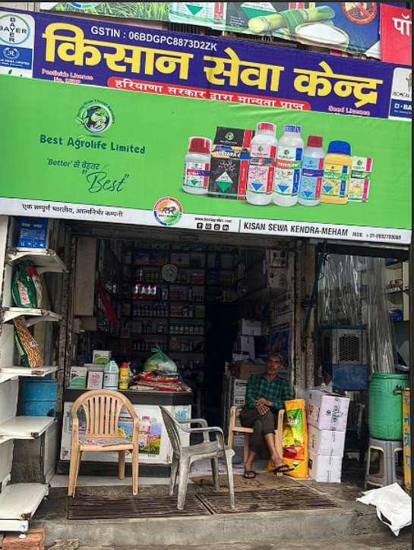
About the Business
It is a Mid-size Business of Fertilizers, Pesticides, and Insecticides located in Meham of Dist. Rohtak in Haryana. The business is B2C and B2B. The Business specializes in offering a wide range of products, to cater the needs of farmers, gardeners, and individuals involved in agricultural activities.

Slide 3

Problem [s]
Impact of weather
Comprehensive Examination of Company's Overall Sales and the Impact of Weather Conditions, Particularly Seasonal Variations, on the Demand for Specific Products.
Outperforming competitors
Strategies for Achieving Higher Revenues Compared to Other Agrochemical Retailers in the Local Area
Empowering Farmers
Enabling Knowledge Transfer and Product Adoption Among Economically Disadvantaged Farmers

Slide 4
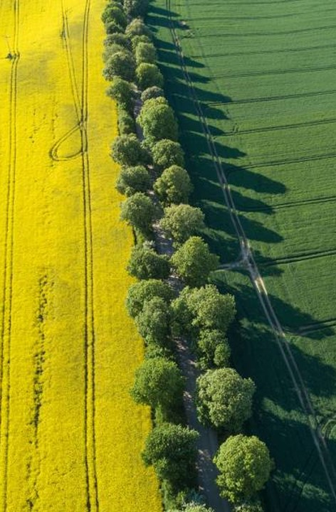
DATA OVERVIEW
Historical sales data
Sales over the Financial
Year 2021-22.
INVENTORY DATA
Stocking Capacity and
Current Stock Levels.
SUPPLY CHAIN DATA
Suppliers, Shipping times,
and Transportation costs
CUSTOMER DATA
Customer behavior and
Preferences From villages.

Slide 5
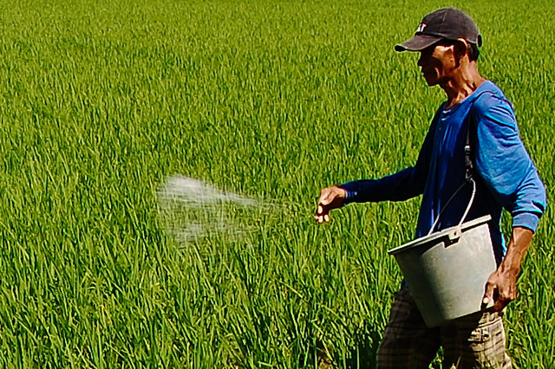
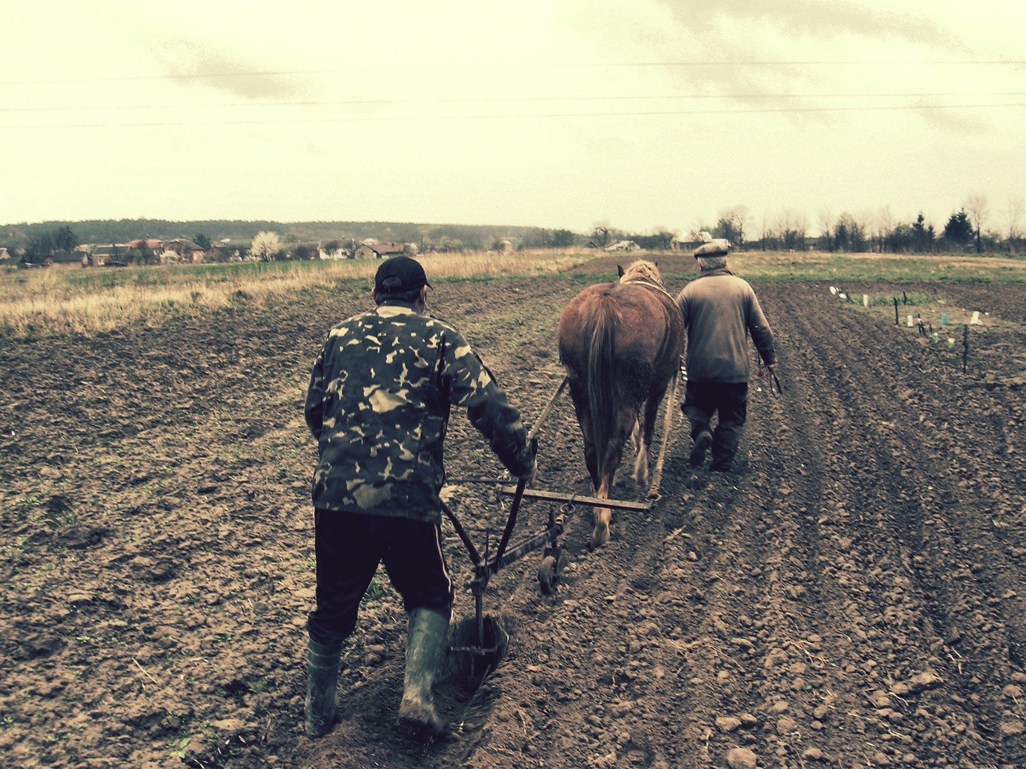
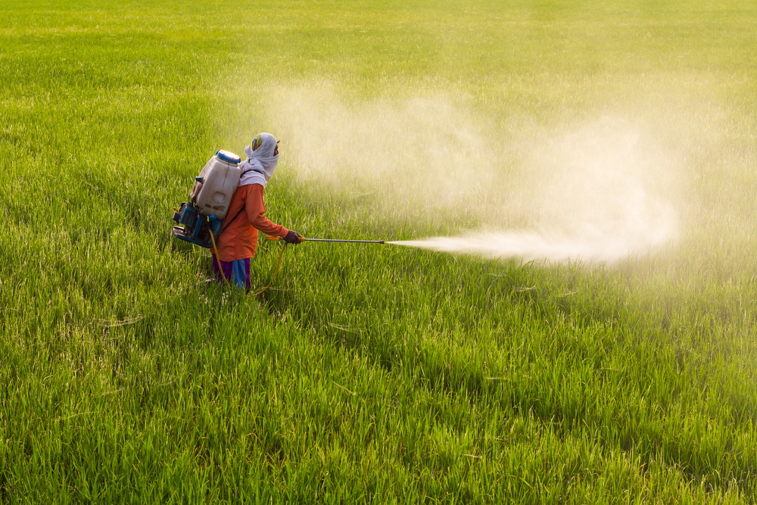
analysis overview
FLUCTUATIONS
To Determine the variation in monthly demand.
pareto analysis
To Check The Star Products in Sales and Revenue.
Sales across different inventory
Upon which category do the farmers rely.

Slide 6
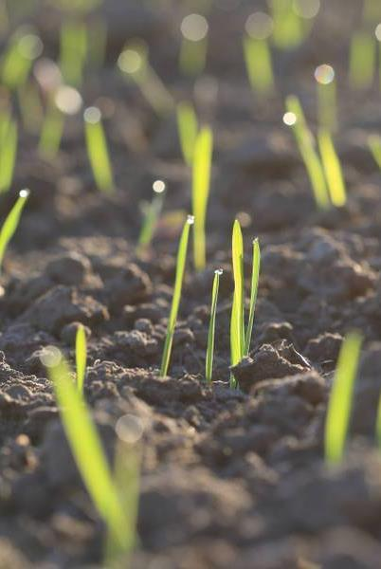
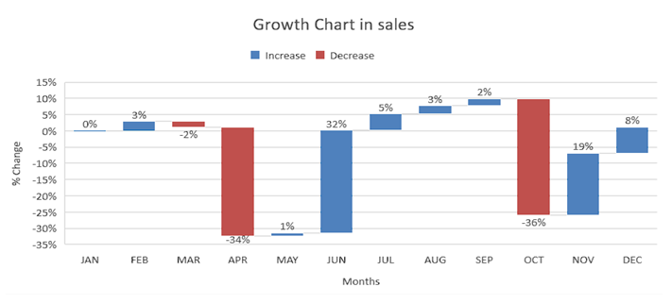
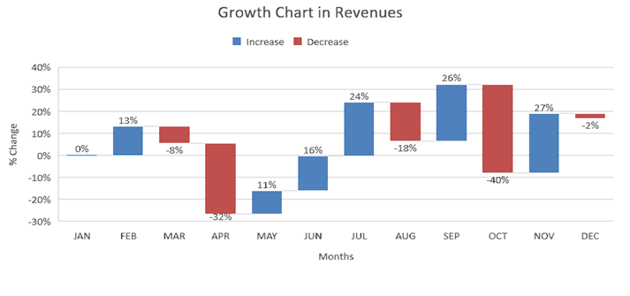
Both graphs distinctly illustrate a noticeable and significant decline occurring abruptly in Sales and Revenue during the months of April and October.

Slide 7
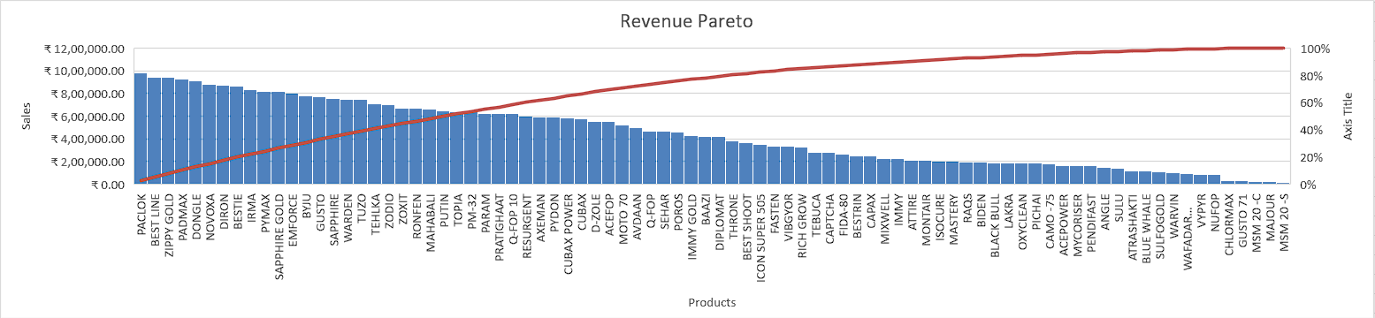

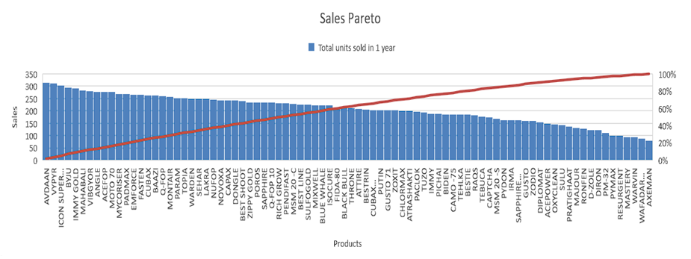
These are The Star Products in Revenue:
PACLOK
BEST LINE
ZIPPY GOLD
PADMAX
DONGLE
These are The Star Products in Sales:
AVDAAN
VYPYR
ICON SUPER 505
BYJU

Slide 8
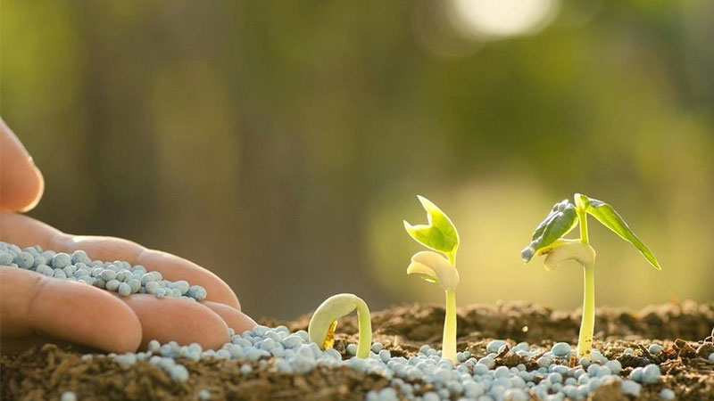
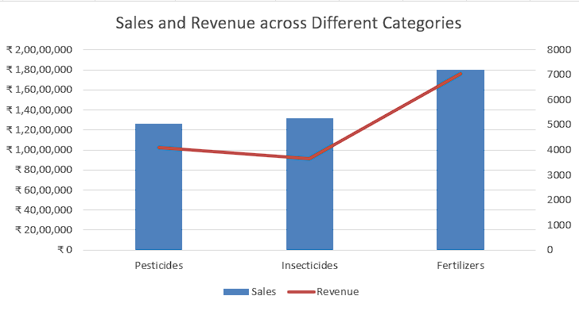
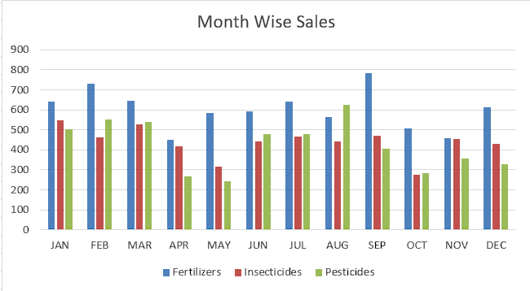
The data unmistakably indicates that fertilizer sales exhibit a noteworthy increase, both in terms of monthly comparisons and over the financial year 2021-22.
An outlier is evident where pesticide sales exhibit a notable increase in the month of August.

Slide 9
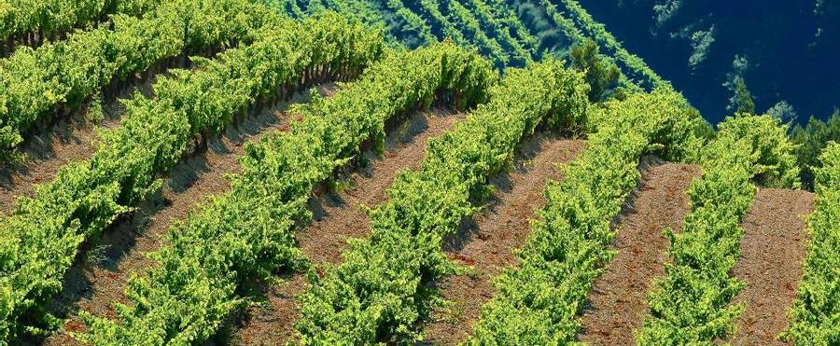
recommendations
Manage inventory to tackle the drop and sudden increase in demand of the product.
Try to target more B2B sales over B2C for more revenue.
Try to promote subsidized Products.
Try to educate The farmers about the correct usage to increase the Yield.

Slide 10

Thank you
GURDEEP
22f3001660

